Slide 1
Mood Scriber Analysis
----Mood scriber

Slide 2
Introduction
I utilized Power BI to visualize the dataset provided by the "Mood Scriber" application.
The dataset encompasses various emotions such as happiness, sadness, anger, depression, feeling rad, awful, neutral, and loneliness, all categorized as moods. Additionally, it includes descriptors of how we feel and the reasons behind those feelings, labeled as Activity1 and Activity2 within the dataset.

Slide 3
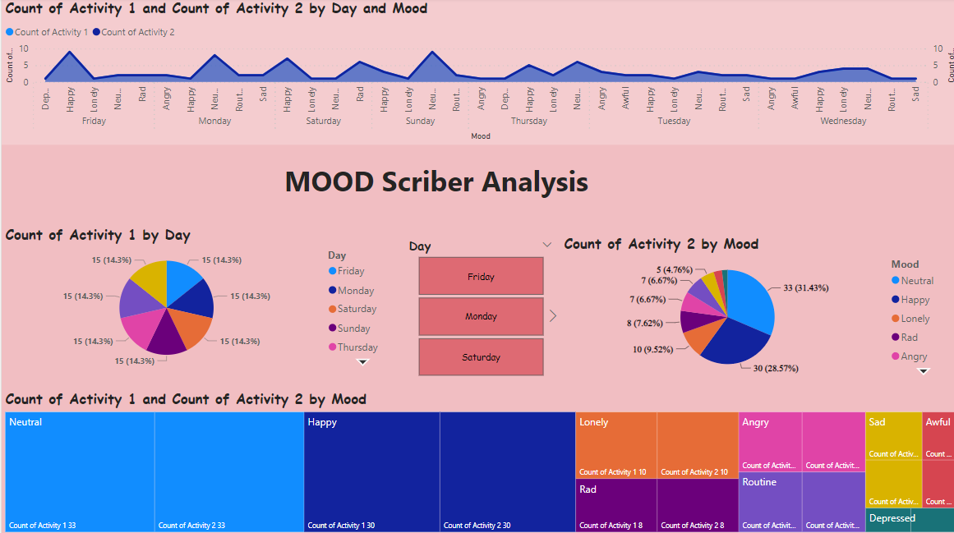
Power BI Analysis

Slide 4
Description
I used line chart to to visualize trends and patterns over a continuous interval or time period.
Then also added a buttons to access specific day also added pie chart to shows the occupancy of the activities over mood. Here I created two individual pie charts.
First one is for count of activity 1 by Mood and second one is for the percentage of activity2 in activity1 as per the mood.

Slide 5
Conclusion
Using the MoodScriber App, I conducted an in-depth analysis, visualization, and dashboard development based on individuals' mood data and the activities influencing their emotions.

